Slide 1

PROJECT SLIDES
CRIME DATA ANALYIS ON BOSTON,USA
BY:HAFSA TABBSUM
BSHTM4
14/05/2025

Slide 2

AGENDA
Introduction
Background
Project Goals/Objectives
Reprocessing and sources of data
Technologies Used
Methodology (workflow)
Initial, introductory findings and progress so far (including visualizations and SQL queries and code so far)
Conclusion (Timeline for further steps) project plan
References and bibliography

Slide 3

INTRODUCTION
Project's Brief Overview:
This project uses analytical tools such as power BI, Excel and Programming tool of RStudio, to identify deeper insights, trends, patterns behaviors towards protection for the public and suggestion for policies regarding crime analysis.
Also useful for end users that are color blind as it provides visualizations suitable for these kind of end users.
This project is specifically useful for law enforcement agencies, other criminal justice agencies, the public, private sectors and government.

Slide 4
Why crime data analysis important and why Boston area chosen for study?
Crime data analysis:
Supports in predicting crimes or incidents that could occur in the future.
Supports in detecting trends of crimes.
It helps governments or lawmakers manage resources, expenditures and improves protection for citizens.
Boston Area:
it is suitable for analyzing data and visualizations as it offers an easily accessible and comprehensively datasets of crime that is documented.

Slide 5
Project objectives
To Develop power BI visualizations and dashboards that are interactive providing visual insights. (for all type of end users) (user-friendly).
Identify trends and patterns of crimes.
Create predictive models for predicting how crimes could increase/ decrease in the future and for analyzing them .
Promote and help reforms in policy and safety of individuals related to making decisions.

Slide 6
Reprocessing and sources of data
Dataset description:
Sources: Boston_Incidents_View_3136327856209597499, tmp2ggq864f, tmpdfeo3qy2. Kaggle, the Boston housing dataset. Data.boston.gov/ crime incidents reports/Boston police data dashboards.
Types of data: excel, csv file includes details of types of crimes, the neighborhoods(location), Year, Month, date, the seriousness of the crime.

Slide 7

Steps in preparing with cleaning of data
1. from the downloaded sets of data, separated duplicates and values that were missing in the excel, csv file, cleaned the dataset and structured it into an easier dataset to follow.
2.Systemized and made the crimes types, including their years, months and neighborhoods(location) look understandable.
3.Using the cleaned dataset, developed plots, visuals and performed some descriptive statistics in excel and imported the dataset into PowerBI to create visualizations of reports and dashboards on crime data analysis. (easier analysis).
4. I also made use of RStudio, programming language to create predictive models such as ARIMA models, multinominal logistic regression model, decision tree and random forest models. Includes some QQ plots, boxplots with some scattered plots.

Slide 8

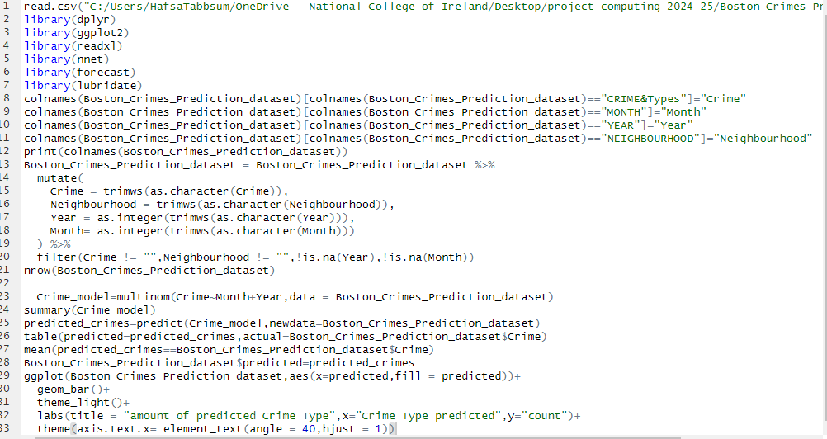
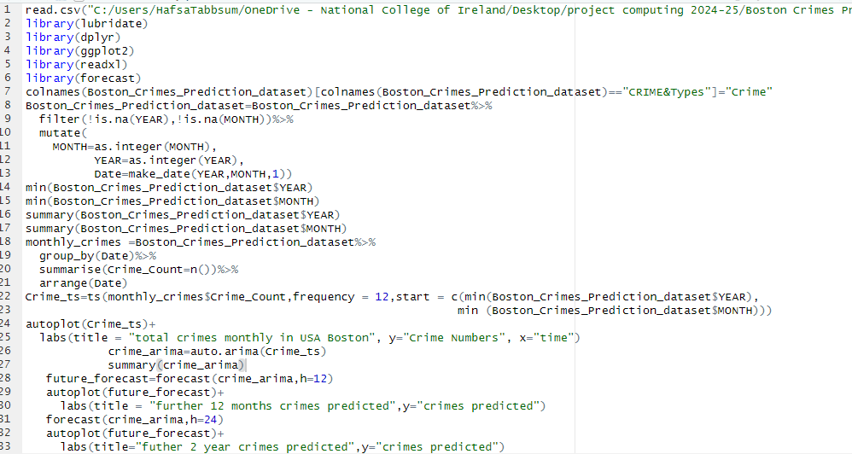
Screenshots of some RStudio codes of developing predictive models
These are codes from R.
Code of Multinominal logistic regression model predicting further 12 months and 2 years.
Code of Arima model for overall crimes yearly and monthly predicting further 12 months and 2 years.
Then I runned each of the line of code in R to ensure the validity of my results, therefore it developed algorithms that were sophisticated and predictive.

Slide 9

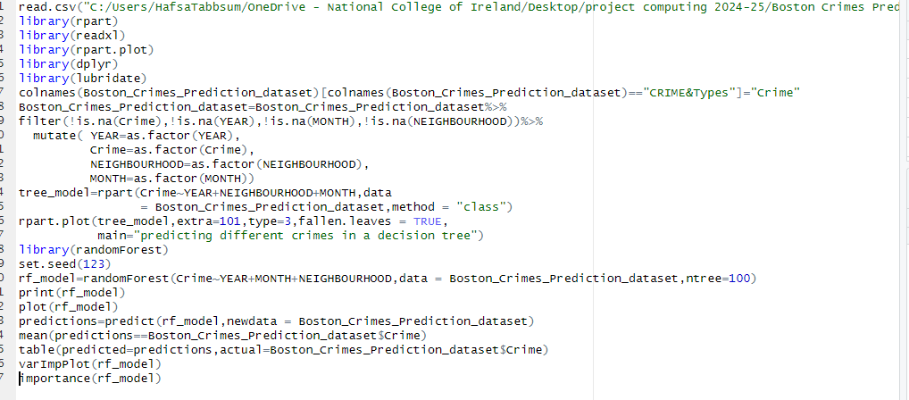



RStudio code of the development of the predictive models of decision tree and random forest. Then I runned each of the line of code in R to ensure the validity of my results, therefore it developed algorithms that were sophisticated and predictive

Slide 10
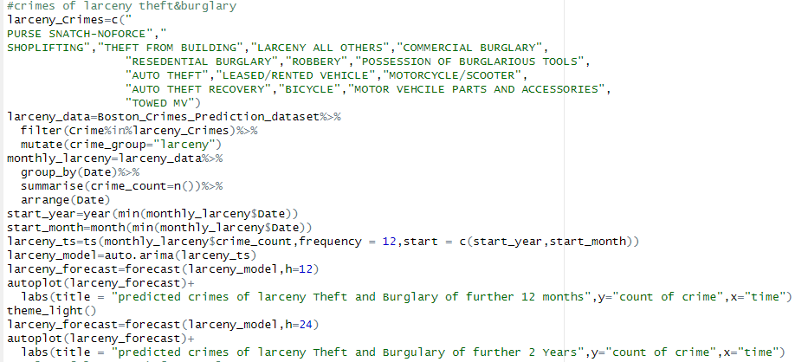
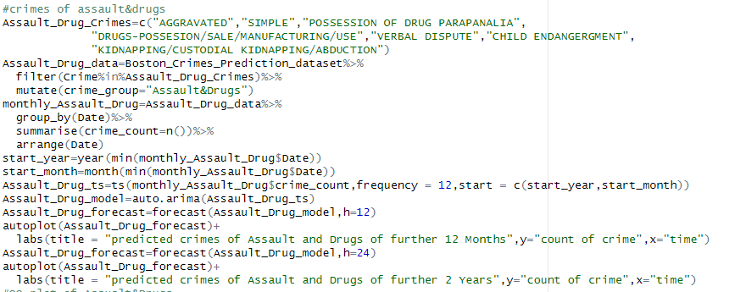
Short R codes when developing each crime model by month and yearly by predicting further 12 months and further 2 years. Examples here are screenshots of Larceny Theft & Burglary crimes and Assault &drug crimes. Then I runned each of the line of code in R to ensure the validity of my results, therefore it developed algorithms that were sophisticated and predictive.

Slide 11
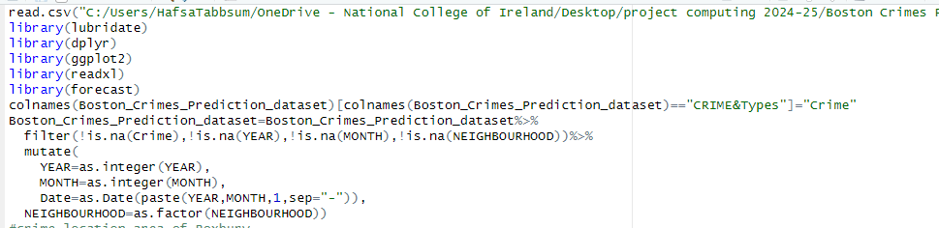
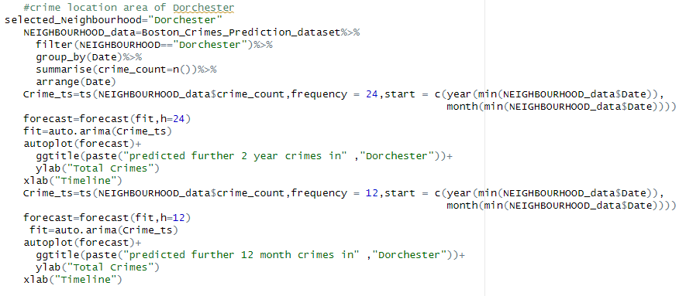
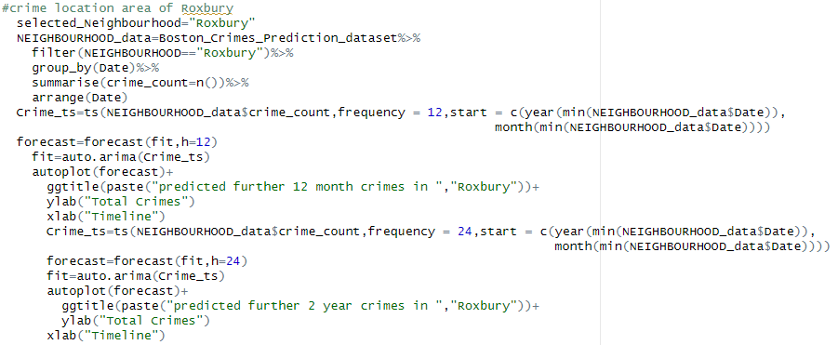
Short R codes of R when developing each crime model by neighborhoods(locations) monthly and yearly by predicting further 12 months and further 2 years. Examples here are screenshots of “Roxbury” and “Dorchester”.
Then I runned each of the line of code in R to ensure the validity of my results, therefore it developed algorithms that were sophisticated and predictive.

Slide 12
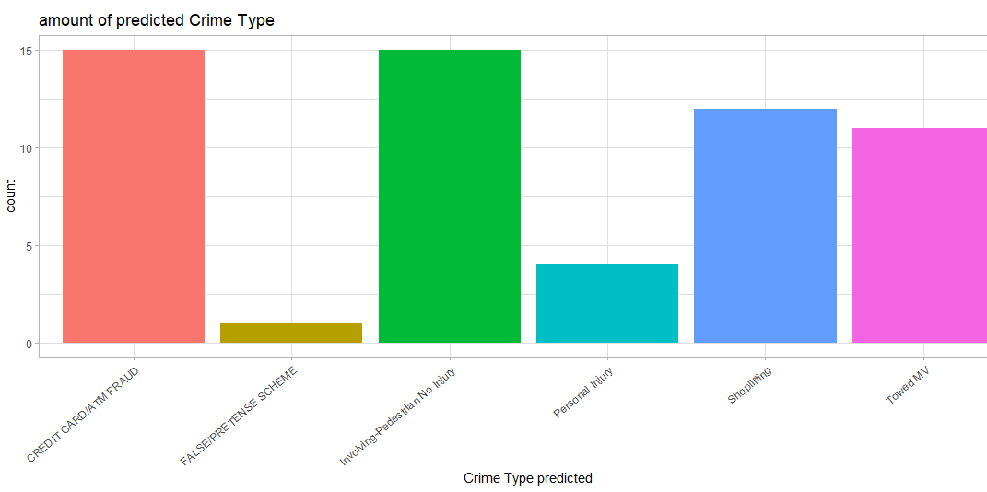
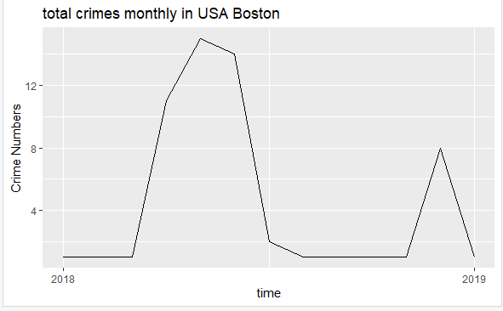
These are screenshots of some predictive models developed by the R codes shown: RESULTS:
1) Multinominal logistic regression model predicting Crimes further 12 months and 2 years.
Arima model for overall crimes yearly and monthly predicting further 12 months and 2 years. ( this shows years 2018 till 2019, this model demonstrates that the rate of crimes rapidly move throughout mids of the year 2018 at maximum, but afterwards they decrease to lower rates before slowly rising once more during the early year of 2019)

Slide 13
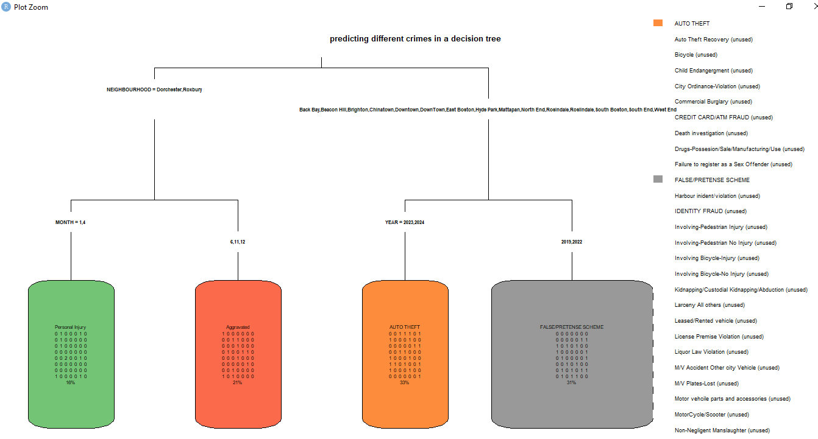
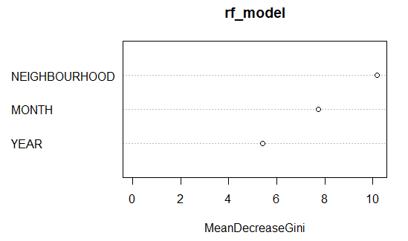
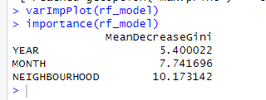
screenshots of the predictive models of decision tree and random forest in Rstudio
1) Tree model is predicting different crimes, the percentages of the specific crimes in the boxes and with the neighbourhood pointed.
2) screenshots of the varimplot developed for the random forest, this indicates that when predicting the results the neighbourhood has become particularly the significant factor of crime analysis afterwards the month and year as neighbourhood in the plot in the x axis is at 10, month is at 8 and year is at 6,
however, these all are important factors for crime analysis of random Forrest. Then the other screenshot confirms the description visually with the mean Decrease Gini, which are values in numbers of every attribute

Slide 14
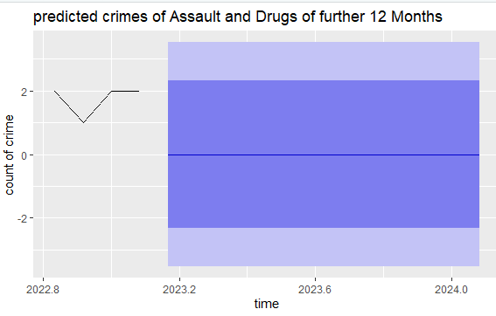
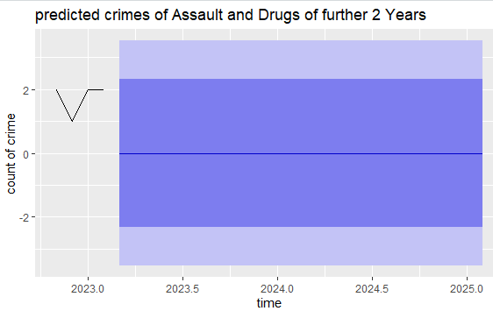
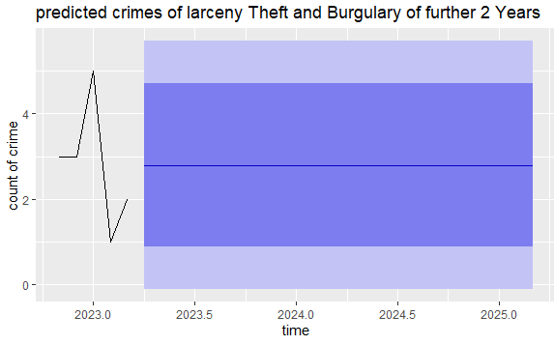
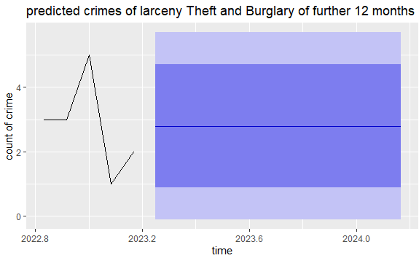
developing each crime model by month and yearly by predicting further 12 months and further 2 years. Examples here are screenshots of Larceny theft and burglary crimes and assault &drug crimes.
1) predicted throughout further 12 months and this indicates that a pattern that is cyclical around the later year of 2022 and blue coloured box shows an elevated inconsistency and throughout of further 2 years indicates that a pattern that is cyclical is around the earlier of 2023 and blue coloured box shows a significant inconsistency
2) predicted throughout further 12 month and 2 years and these plots indicates that an achievable value range across 1 to 5, including an consistent average around 3 and also previously to the current representation, the data that is historical, indicates that there was some variation such as increasing or decreasing of crime numbers. (black line).

Slide 15
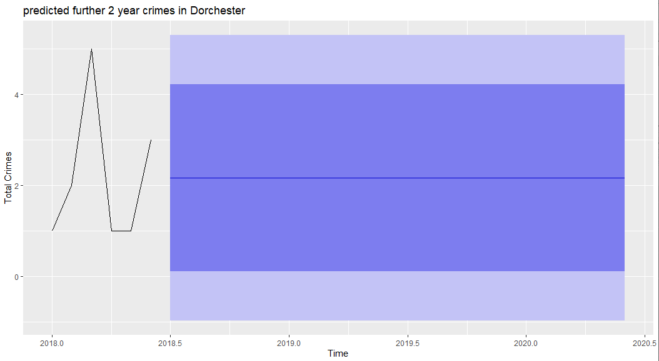
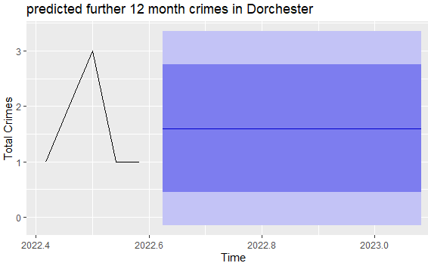
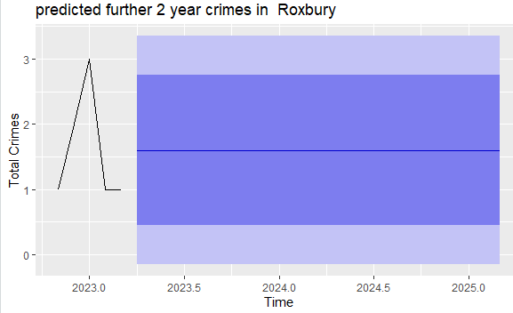
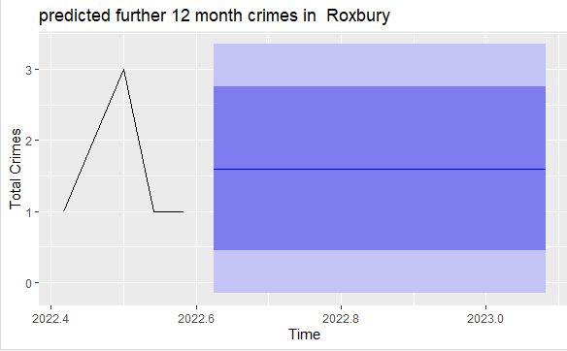
developing each crime model by neighborhoods(locations) monthly and yearly by predicting further 12 months and further 2 years. Examples here are screenshots of “Roxbury” and “Dorchester”.
“Dorchester” models displays an increase in the historical data of the crime in the middle year of 2022, coloured blue line showing average of all crimes occurring in the following year further 2 years in Dorchester, this plot shows the extended amount of duration it takes , the greater uncertainty of prediction is and the plot displays the trends of the historical crimes of the year 2018. e
“Roxbury” Models of further 12 months, This plot indicates a rise in crimes of total throughout the year 2022 and the month May, which follows through a decrease and the total number of crimes is shown by the coloured horizontal line of blue in the light blue shaded huge box which shows unpredictability.
predictions for the next For further 2 Year crimes, plot indicates that like the Roxbury plot(just year changed), a rise in crimes of total throughout the year 2023 and the month May, which follows through a decrease.

Slide 16
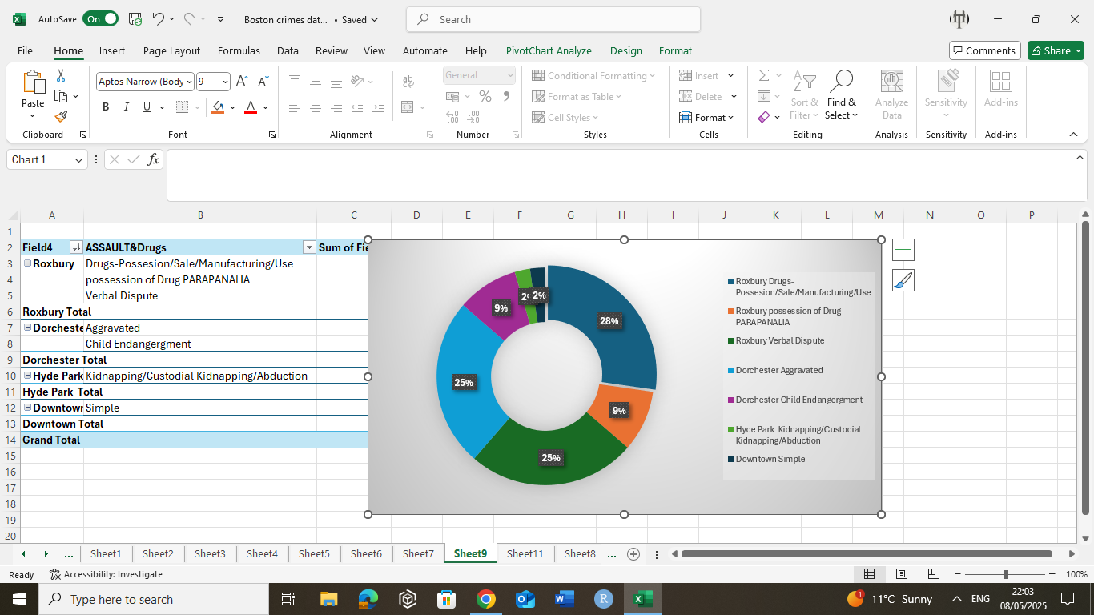
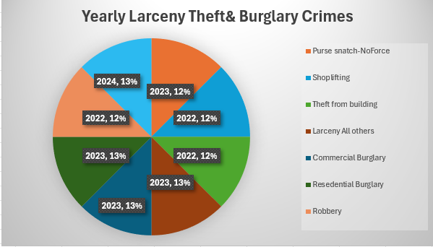
Some Screenshots of Visuals Developed from EXCEL
These visuals are pie charts of the proportion percentages of each crime type occurred for the crimes of assault and drugs throughout the neighbourhoods and yearly crimes of larceny theft &Burglary.

Slide 17
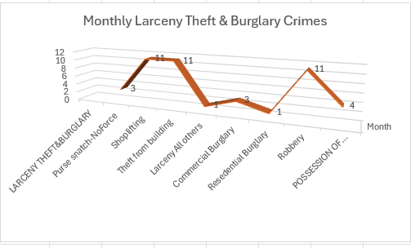
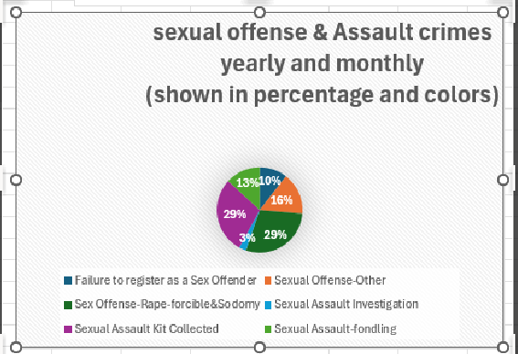
1) 3d visual indicating the larceny theft and burglary crimes monthly.
2)pie chart indicating sexual assault crimes yearly and monthly and different colours showing the crime type percentage of occurrence. Such as the highest percentages are for the crime types sexual assault kit collected (29%) and sexual assault fondling(29%).

Slide 18
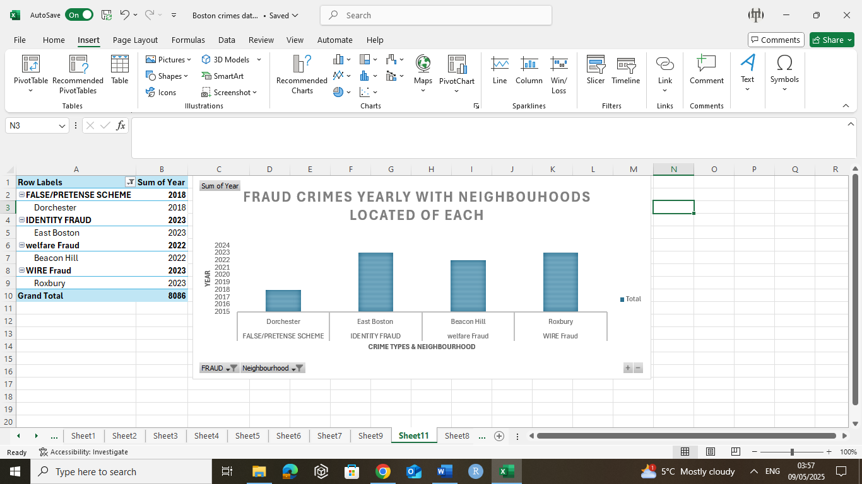
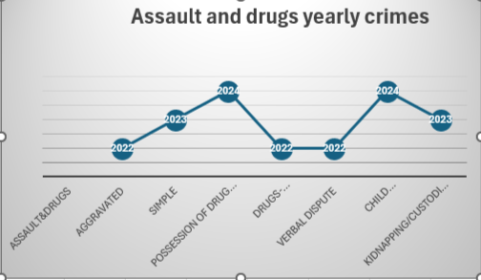
These indicate a bar chart of fraud crime types yearly with specified neighborhoods they occurred in with the grand total of crimes occurred in the pivot table at the end of 8086. a line chart showing the trend of the yearly assault and drug crimes and the crimes are also fluctuating such as increasing and decreasing as year goes by as seen in the chart.

Slide 19
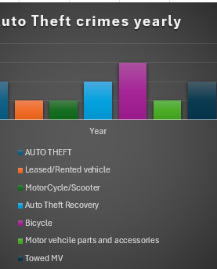
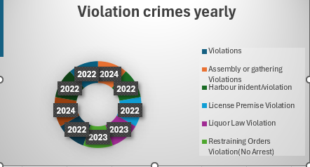
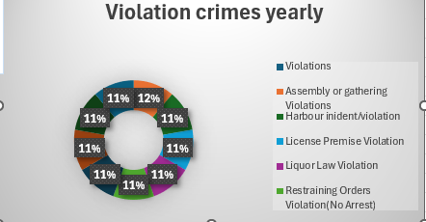
pie chart of different type of violation crimes that occurred yearly with proportions indicating each crime. They are all high with 11% of proportions in different years as seen in the chart, but the highest one is in the year 2024, with the percentage of 12% for the crime type of assembly or gathering violations. Each colour is indicating the crime type with the specific year and the proportion of the crime type bar chart of how much of auto theft crimes occurred yearly. Which can be visualized by different colours specifying which crime type was highest to the lowest such as highest one was the bicycle theft crimes occurred in the year 2024, then next highest was in the year 2023, the auto theft recovery crimes and specific auto thefts and towed MV crimes, then the lowest ones were in year 2022, the leased rented vehicle, motor cycle/scooter and motor vehicle parts and accessory crimes

Slide 20
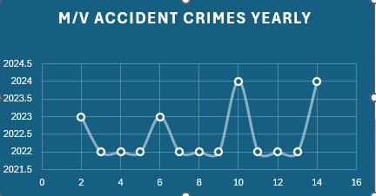
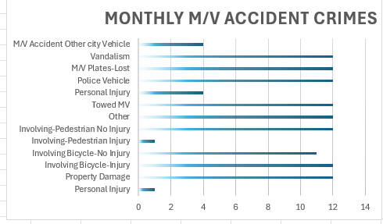
gantt chart and line charts of the specific M/V accident crimes monthly and yearly

Slide 21
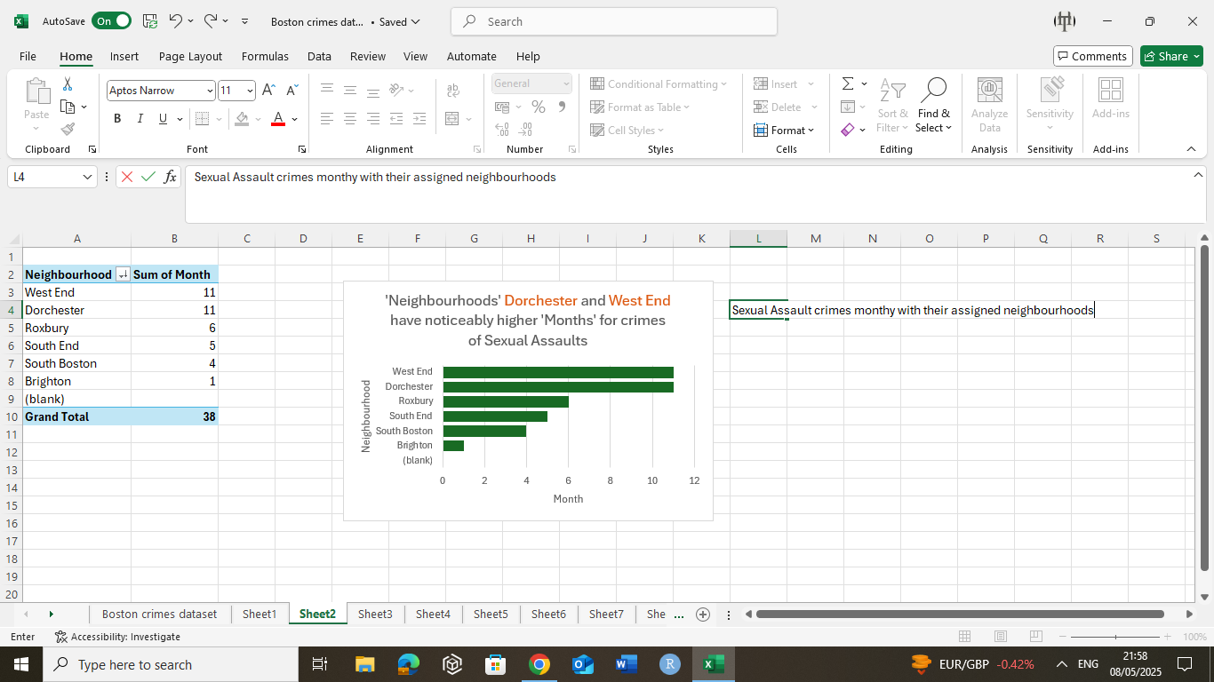
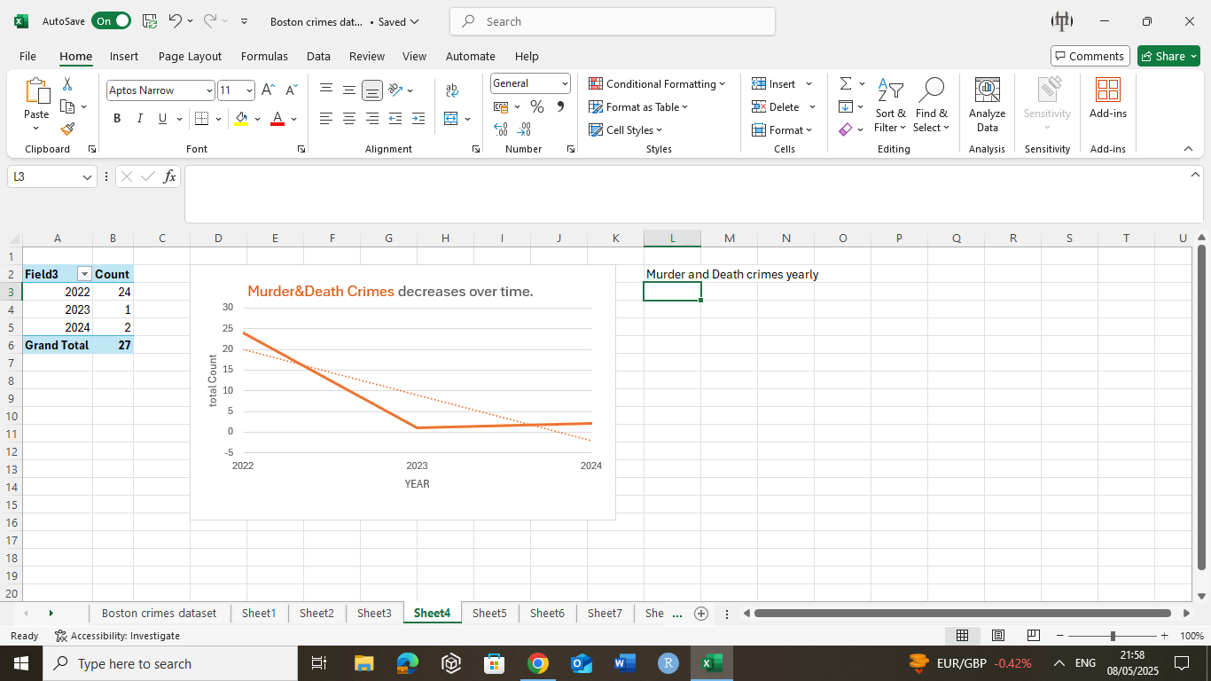
bar chart of sexual assault crimes monthly with their neighborhoods(locations) specified. Such as 10 (October) month has the highest sexual assault crimes in west end and Dorchester and the least one in Brighton line chart indicating murder and death crimes yearly with its total counts of each crimes yearly. Showing these crimes are decreasing over years

Slide 22
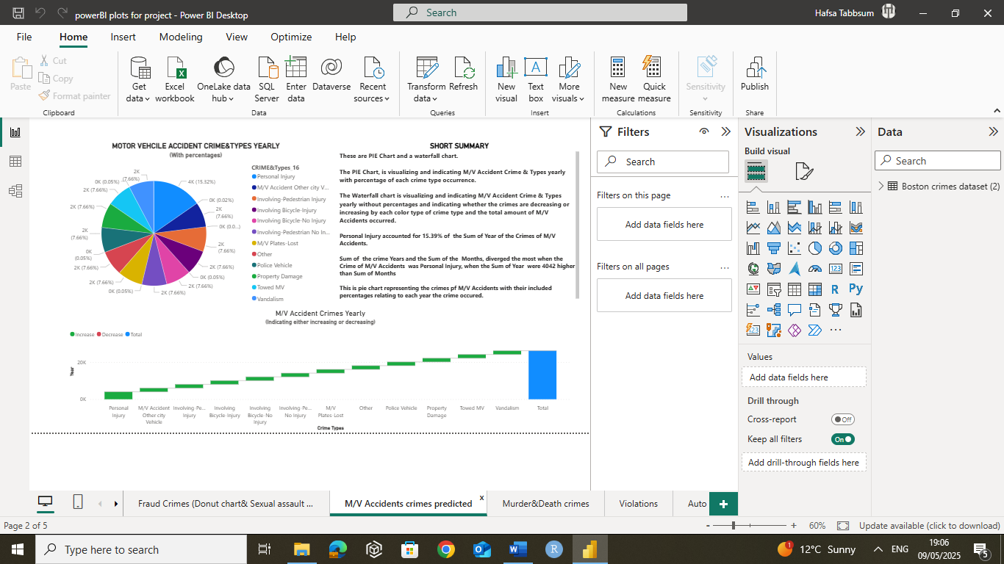
Some screesnhots Power BI dashboards of visualizations developed Specific blue and red color dashboards for color-blinded end users. (high—contrasted colors)

Slide 23
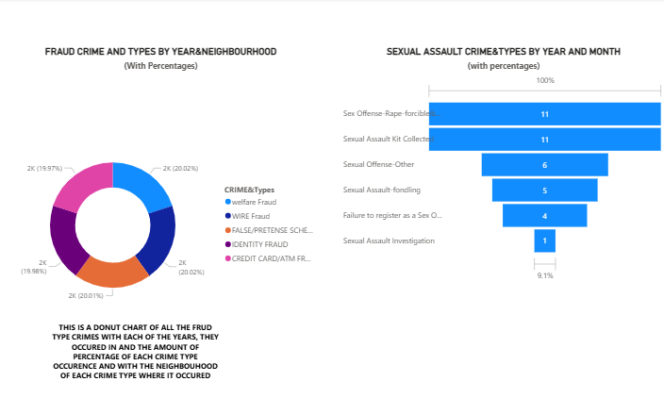

Slide 24
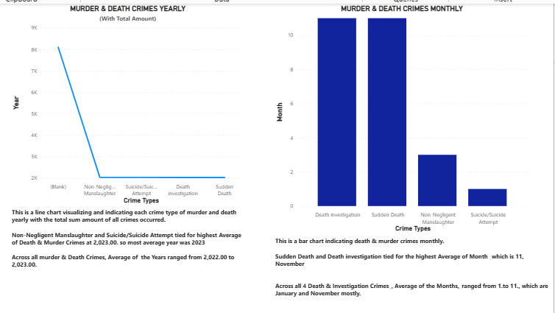

Slide 25
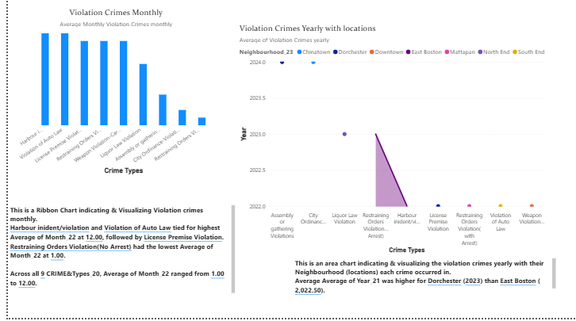

Slide 26
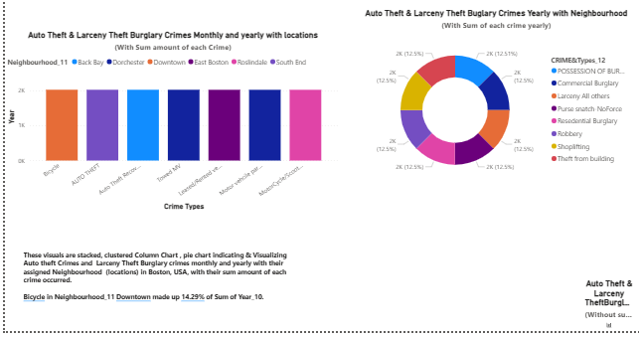

Slide 27
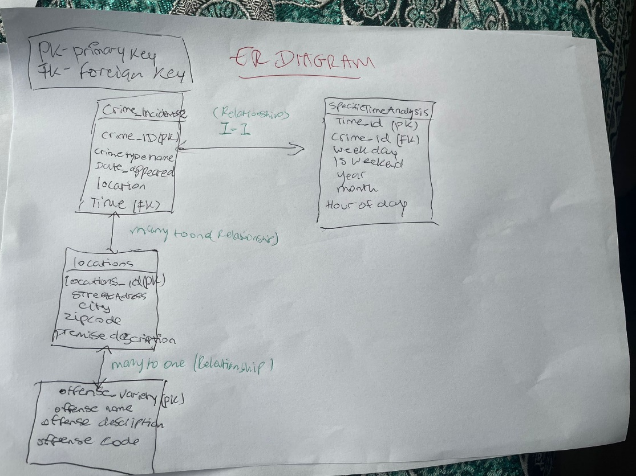
Entity-relationship diagram
Includes entities, necessary Foreign and Primary Keys and relationships with one another of the tables.

Slide 28
In conclusion, the Highest and lowest crimes found after my overall crime analysis research that governments or law enforcement agencies could have a look at conder focusing on these crimes
HIGHEST AND increasing CRIMES:
auto theft crimes (Bicycle thefts)
Assault & drug crimes (possession of drugs, PARAPANLIA)
M/V Accident crimes(Vandalism)
Sexual Assault crimes(Failure to register as a Sex Offender and Sexual Assault-fondling)
larceny theft and burglary(robbery, shoplifting and purse snatching )
LOWEST AND DECREASING CRIMES:
murder and death crimes as its predicting very low, and the M/V accident crimes, also some violation crimes very less, and some fraud crimes are decreasing, however the focus still should be on lowering the crimes

Slide 29

highest & lowest Neighborhoods (areas) found after my overall crime analysis research.
HIGHEST Neighborhoods of crimes found:
Dorchester
West End
Roxbury
Brighton
Downtown
North End
Beacon Hill
LOWEST Neighborhoods of crimes found:
China Town
Roslindale
Mattapan
West End
South End

Slide 30
highest & lowest Years and Months found of crimes after my overall crime analysis research.
HIGHEST Years & Months in Which crimes occurred mostly:
2022, 2023 and 2024
12, which is December 11, which is November 2(February) and 4 April.
Showing that crimes are occurring more into season wise for example into winters, and summer also.

Slide 31
References and bibliography
https://data.boston.gov/dataset
(Anon., n.d.)
(SreeKumar, 2023)
https://paperpal.com/blog/academic-writing-guides/what-is-research-methodology
(Anon., n.d.)
https://bja.ojp.gov/sites/g/files/xyckuh186/files/media/document/OverviewofCrimeAnalysis.pdf
(Akdeniz, 2019)
https://www.kaggle.com/code/ismailsefa/crimes-data-analysis-and-visualization-eda
(Sharma, 2024)
https://link.springer.com/chapter/10.1007/978-3-031-61047-9_19

Slide 32

Thank you!

